Slide 1
Magnolia Flash Sessions
Session 4: History Reference center & literary reference center

Slide 2
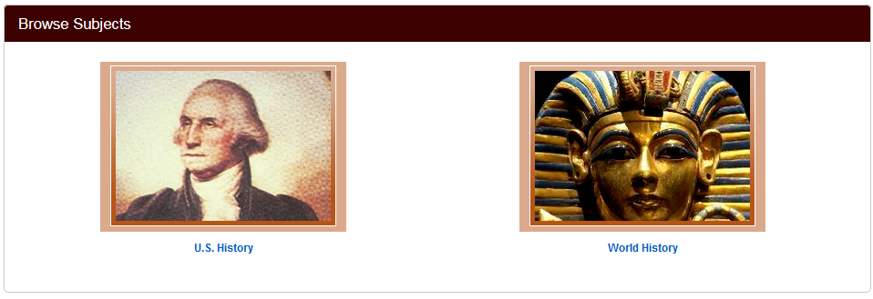
History reference center
History Reference Center is the world's most comprehensive full text history reference database designed for secondary schools, public libraries, junior/community colleges, and undergraduate research. The database features full text for more than 1,620 reference books, encyclopedias and non-fiction books from leading history publishers

Slide 3
Basic/Advanced search
Basic search
This works just like Academic Search Premier and most other Ebsco Databases
Advanced Search
Search History
Tool bar at the top of the screen: “More” contains the image/video search.

Slide 4
Browse by
subjects
Popular sources
US History
World History
You can choose to search within an array of popular historical series.

Slide 5
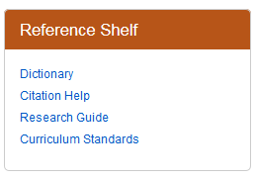
Reference shelf

Slide 6
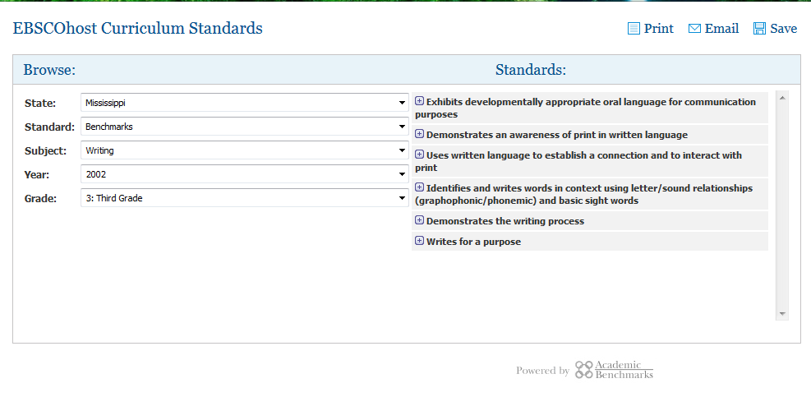
Curriculum standards

Slide 7
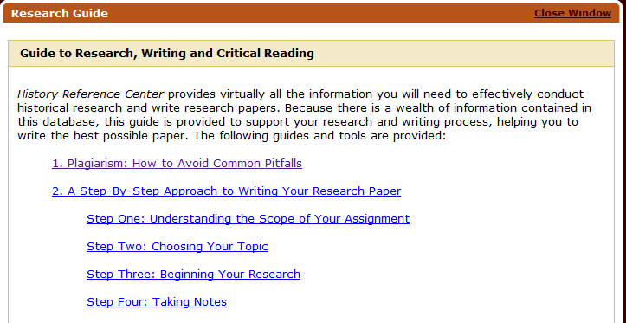
Research guide

Slide 8
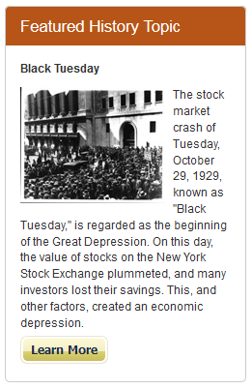
Featured history topic

Slide 9
Literary reference center
Literary Reference Center™ is a comprehensive database that provides users with a broad spectrum of information on thousands of authors and their works across literary disciplines and timeframes. It has been specifically designed for public libraries, secondary schools, junior/community colleges, and undergraduate research. Literary Reference Center is a full-text database that combines information from thousands of major respected reference works, books, and literary journals as well as original content from EBSCO Publishing. Content includes thousands of plot summaries, essays of literary criticism, author biographies, book reviews, classic and contemporary poems, classic and contemporary short stories, and author interviews.

Slide 10
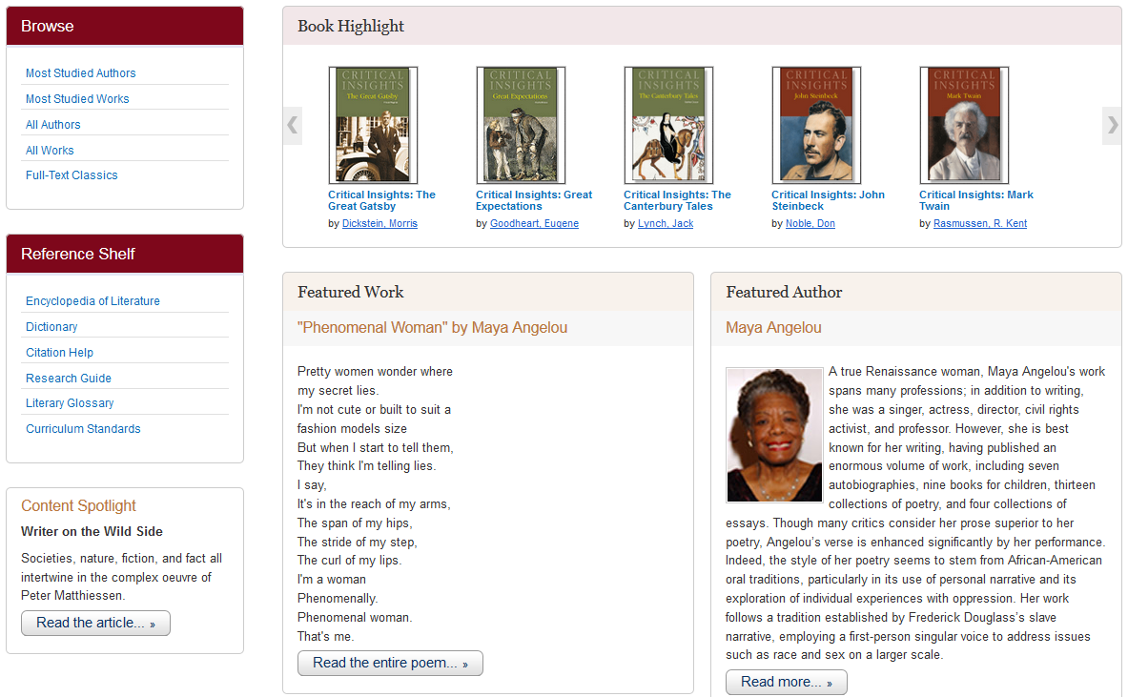

Slide 11
searching
basic
advanced
This works just like Academic Search Premier and most other Ebsco Databases
Offers many more options regarding authors and works.

Slide 12
Homepage FEatures
Book Highlights
Featured author & work
Critical insights
Author-specific
Work-specific
Information on the author, with links to biographical article.
Featured work with link to full text.

Slide 13
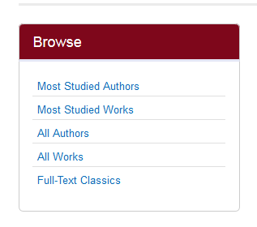
Browse by
The browse function allows you to search via author and work.
The Full-Text Classics feature includes Masterplots summaries as well as the full text of a number of classics.

Slide 14
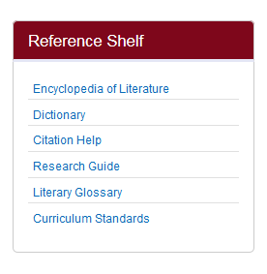
Reference shelf
Just like the History Reference Center, this includes:
Dictionary
Citation Help
Research Guide
Curriculum Standards
The Literary Reference Center includes to additional resources:
Encyclopedia of Literature
Literary Glossary

Slide 15
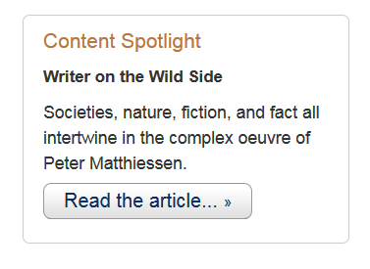
Content spotlight
This features materials in the database and links to the full text article.

Slide 16
Questions?
Joy Garretson
Library Development Director
Mississippi Library Commission
601-432-4498
jgarretson@mlc.lib.ms.us
Lucinda Ogden
Continuing Education Coordinator
Mississippi Library Commission
601-432-4057
logden@mlc.lib.ms.us

